Slide 1

May Showcase
AI Forward Award Winners
6 Innovators. 5 Minutes Each.
30 Minutes of Collective Impact
forumFollowed by Audience Q&A

Slide 2


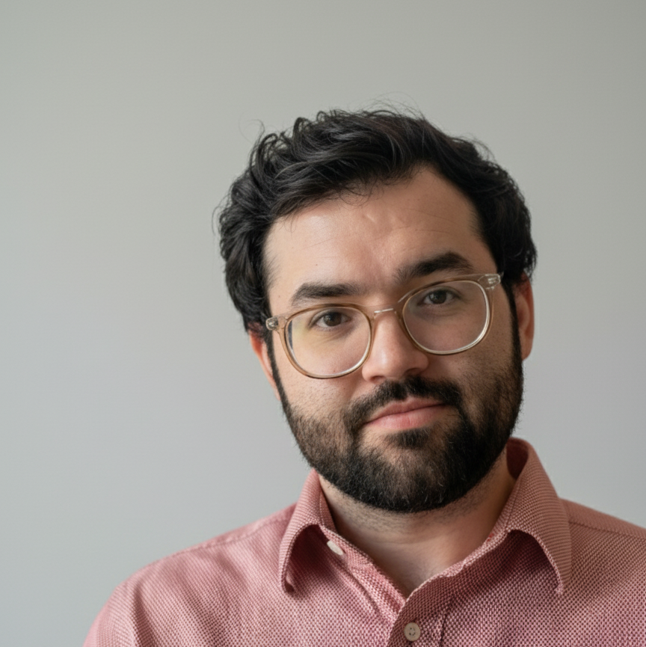
AI Forward Winner:
Martin Mena
Marketing Configuration Specialist
Project: Trend Tree System

Slide 3
The Signal
Real voices — people over multiple months, independently wished for the same thing.
“We booked a hotel and the plan is literally to sit and read in the same room and order room service.”
AI scouts — Gemini, Grok & ChatGPT separately flagged ‘literary tourism’ out on the open web.
AI agents uncovered a collection of signals:
Plot-Driven PTO

Slide 4
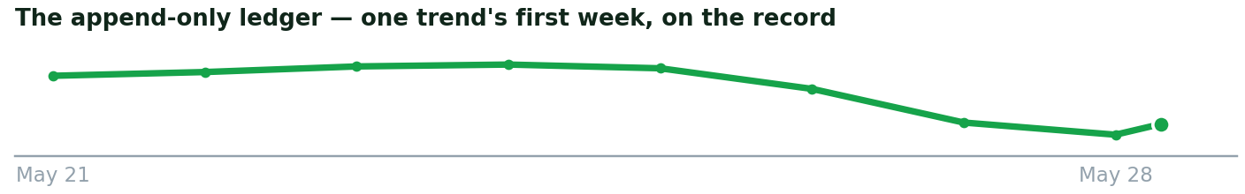
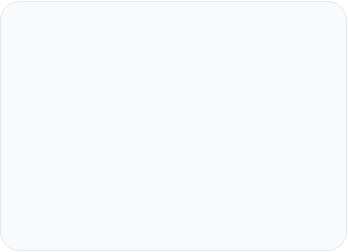
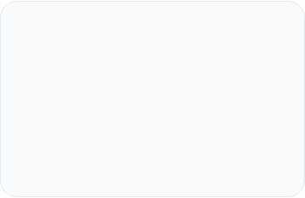
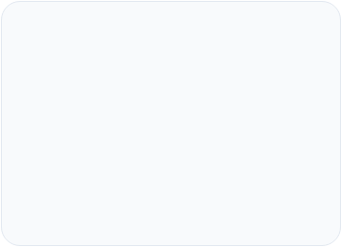



The Decision
Discovery & Ingestion
Distillation & Promotion
Lifecycle
Autonomous listeners tap multiple sources, 24/7 — no human deciding what to search for.
Agents decide for themselves: a brand-new trend, or more proof for one we already track?
Every change lands on an append-only ledger — replay the trend’s whole history.

Slide 5
The Payoff
Every trend the system finds is a content opportunity.
Audience
who it reaches
Content Gaps
what we may be missing
Monetization
how it pays
Trend Tree increases speed to market while keeping our efforts focused
Plot-Driven PTO is one trend of 200+ that have been surfaced

